Slide 1
NAS Systems and File Servers
Where Data Lives Cozy and Connected!

Slide 2
What is NAS?
A specialized storage device connected to a network.
Provides centralized, consolidated disk storage.
Accessible by multiple clients across different operating systems.

Slide 3
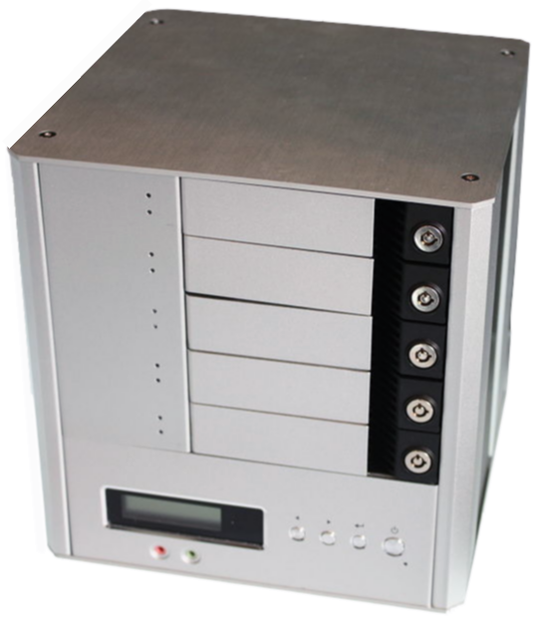
What is NAS?
Source
Wikipedia

Slide 4
Key Features of NAS
Ease of Access & Setup:
Designed for simplicity in setup and operation.
Offers built-in operating systems optimized for file storage and sharing.
Data Availability:
Ensures data is consistently available to authorized network users.
Often comes with redundancy features (like RAID) to protect against data loss.

Slide 5
What are File Servers?
General-purpose servers that provide file storage services to clients.
Often part of a larger server offering various services beyond just file storage.

Slide 6
NAS vs. Traditional File Servers
Dedication to Storage:
NAS: Highly specialized for storage, offering plug-and-play functionality.
File Servers: Versatile, handling storage along with other server roles.
Complexity and Cost:
NAS: Typically lower in cost with minimal setup complexity.
File Servers: Potentially higher cost, requiring more setup and maintenance, especially if serving multiple roles.
Performance:
NAS: Optimized for file storage and sharing; may have performance limitations for other server roles.
File Servers: Configurable for high performance across multiple roles, including file storage.

Slide 7
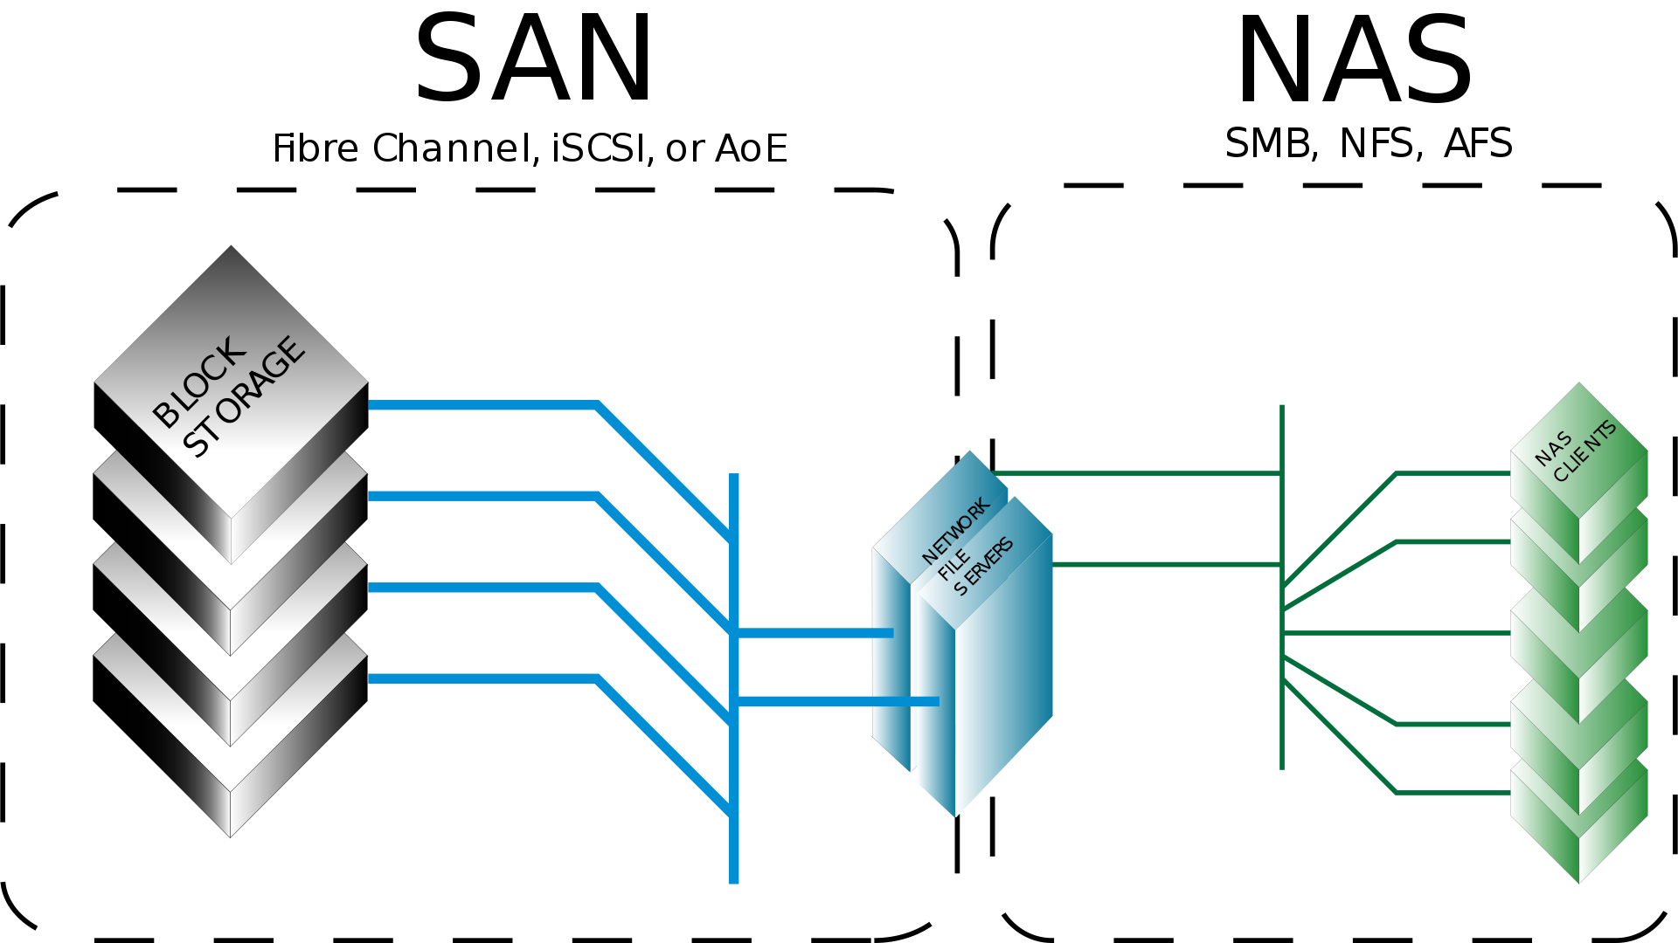
NAS vs. Traditional File Servers
Source
Wikipedia

Slide 8
Advanced File Serving with Windows
Overview: Windows takes file serving to the next level with advanced features.
Key Features:
Storage Pools: Group multiple hard drives to create a larger storage space.
Replication: Ensures data is copied and maintained across different storage locations.
High Availability: Minimizes downtime and ensures data is always accessible.

Slide 9
Why Consider Windows for File Serving?
Scalability: Ideal for organizations looking to scale their storage solutions.
Integration: Seamless integration with existing Windows-based infrastructure.
Advanced Features: Offers robust solutions like Storage Spaces Direct, DFS Namespaces, and DFS Replication.

Slide 10
Open Source Alternatives for Advanced File Serving
FreeNAS/TrueNAS:
Description: A powerful, flexible open-source storage platform based on FreeBSD.
Storage Pools: Supports ZFS for creating storage pools with robust features like snapshots, replication, and compression.
Replication: Built-in support for ZFS replication.
High Availability: Offers plugins for various high-availability solutions.

Slide 11
Open Source Alternatives for Advanced File Serving
GlusterFS:
Description: A scalable network filesystem that allows rapid provisioning of additional storage based on your storage needs.
Scalability: Excellent for scaling horizontally by adding more nodes.
Replication & High Availability: Supports data replication across various storage volumes and high availability through self-healing and rebalancing.

Slide 12
Open Source Alternatives for Advanced File Serving
Ceph:
Description: A unified, distributed storage system designed for excellent performance, reliability, and scalability.
Storage Pools: Provides highly scalable and robust storage solutions using commodity hardware.
Replication & High Availability: Ensures data safety through replication and erasure coding, designed for high availability and reliability.

Slide 13
Why Consider Open Source Solutions?
Cost-Effectiveness: Generally lower cost than proprietary solutions, with many solutions available for free.
Flexibility & Customization: High degree of customizability to meet specific organizational needs.
Community Support: Strong community support, with the advantage of collective troubleshooting and improvements.
Transparency: Open-source code allows for auditability and understanding of the software's inner workings.

Slide 14
Key Features of NAS (Network-Attached Storage)
1. Simplicity & Speed of Deployment:
Plug-and-play setup.
Intuitive interfaces for management.
2. Fault Tolerance:
Redundancy options (RAID configurations).
Hot-swappable drives for uninterrupted service.
3. Scalability:
Effortless addition of more storage.
Capability to meet growing data demands.
4. Easy Backup & Recovery:
Integrated backup solutions.
Support for snapshot technology and replication.

Slide 15
NAS for Small and Medium-Sized Businesses (SMBs)
Cost-Effectiveness
Budget-friendly storage solutions.
Low operational and maintenance costs.
Centralized File Storage
Single storage hub for all business data.
Simplified data management and accessibility.

Slide 16
NAS in Creative Industries
High-Capacity Storage
Ideal for storing large multimedia files.
Easily handles video, audio, and image libraries.
Fast Data Transfer
Quick file access and sharing among team members.
Supports intense workflows and deadlines.

Slide 17
NAS in Surveillance and Security
Integration with IP Cameras
Seamless connectivity with multiple IP cameras.
Centralized storage of surveillance footage.
Scalable Storage
Easy expansion of storage as surveillance needs grow.
Efficient management of large volumes of video data.

Slide 18
NAS in Research and Academic Institutions
Storing Extensive Databases and Materials
Capable of handling large datasets and research materials.
Secure storage of sensitive academic records.
Collaborative Benefits
Facilitates data sharing among researchers and students.
Supports remote access and collaborative projects.

Slide 19
NAS Configuration
Initial Setup: Basic setup steps (network connection, IP settings, user accounts).
Storage Configuration: RAID configuration, levels, and use cases.
Access and Security: Network shares, access rights, firmware updates, security patches.
Data Backup and Recovery: Role in backup strategies, off-site backups for disaster recovery.
Performance Optimization: Tips for maintaining optimal performance.

Slide 20
Integrating NAS into Existing IT Infrastructure
Compatibility and Interoperability: Compatibility with different OS and network environments.
Scalability and Future-proofing: Scaling NAS systems with growing data requirements, considerations for future expansion.

Slide 21
Compatibility and Interoperability
Protocol Support and Integration: NAS systems must support various network protocols like SMB (for Windows), NFS (for Unix/Linux), and AFP (for macOS) to ensure seamless integration across different operating systems. Effective NAS systems are designed to work with multiple protocols simultaneously, allowing diverse client OS environments to access shared storage resources efficiently.
User Authentication and Access Control: Compatibility with different OS includes integrating with their respective authentication systems. A NAS should be compatible with Active Directory (AD) for Windows, LDAP for Linux, and Open Directory for macOS. This ensures that user credentials and access permissions are consistently managed across different networked environments.

Slide 22
Compatibility and Interoperability
File Locking and Permissions: Ensuring that file locking and permissions work consistently across different operating systems is crucial. This prevents issues like data corruption or unauthorized access when multiple users from different OS environments are accessing or modifying the same files on the NAS.
Network Configuration and Management Tools: Compatibility extends to network configurations as well. NAS systems should have flexible network configuration capabilities to adapt to various network setups (like DHCP, static IPs) and should provide management tools that are accessible and functional across different platforms.

Slide 23
Compatibility and Interoperability
Cross-platform File Services and Data Protection: The NAS should handle cross-platform file services, ensuring data integrity when files are accessed and modified from different OS platforms. Additionally, it should support universal data protection measures like RAID configurations and have the capability to implement OS-agnostic backup and recovery solutions.

Slide 24
Scalability and Future-proofing
Hardware Scalability: NAS systems must be designed to handle increased storage demands without significant performance degradation. This involves using scalable hardware components like expandable memory and multi-core processors. For example, some NAS systems support hot-swapping of drives, allowing for storage expansion without downtime.
Volume Management: Efficient volume management is crucial in scaling NAS systems. Techniques like thin provisioning, where physical storage is allocated dynamically based on demand, ensure efficient use of resources.

Slide 25
Scalability and Future-proofing
Network Infrastructure: As data demands grow, the network infrastructure supporting NAS must also be scalable. This includes upgrading network bandwidth capabilities and implementing advanced network interfaces, such as 10 Gigabit Ethernet, to handle increased traffic.
Data Deduplication and Compression: These technologies are vital for scaling NAS systems. Deduplication removes duplicate copies of data, and compression reduces the size of data. Both significantly increase storage efficiency, especially in environments with large volumes of redundant data, like backup systems.

Slide 26
Scalability and Future-proofing
High Availability and Fault Tolerance: As the amount of data stored in NAS systems increases, ensuring data availability becomes more critical. Implementing RAID configurations for redundancy, clustering for fault tolerance, and regular backup strategies are essential components of a scalable NAS infrastructure.

Slide 27
SMB (Server Message Block)
Primary protocol for Windows-based network file sharing.
Enables access to files, printers, serial ports, and other resources on a network.
SMB 3.0 offers enhanced features for virtualization, including:
Improved security with encryption.
Performance optimization for virtual machine (VM) storage.
Resilience in case of a temporary loss of network connectivity.

Slide 28
NFS (Network File System)
Standard protocol used to share files over a network.
Predominantly utilized in Unix/Linux environments.
Known for its simplicity and high-performance capabilities.
Ideal for distributed file systems, allowing users to access files remotely as if they were local.
Supports various versions with NFSv4 providing improved security and performance.

Slide 29
NAS Integration in Hypervisor Environments
Hypervisor Compatibility
NAS systems support major hypervisors.
Compatible with file-based storage protocols like NFS and SMB.
File Locking Mechanisms
NAS itself does not directly provide file locking.
Supports applications (e.g., Word, VMware Workstation) that use file locking to prevent simultaneous write conflicts and ensure data integrity in multi-user environments.

Slide 30
NAS Integration in Hypervisor Environments
Clustering and Resource Management
NAS systems seamlessly integrate with hypervisor clustering.
Facilitates effective resource management of virtual machines.
Optimizations for Hypervisor Workloads
NAS systems specifically optimized for virtualization tasks.
Ensures enhanced performance and reliability for VM operations.
VM-Specific File Systems
Incorporates specialized file systems tailored for efficient VM management.
Aims to improve VM performance and data handling capabilities.

Slide 31
SAN vs. NAS
SAN (Storage Area Network)
Use Cases
High-Performance Computing: Handling complex computations with speed and efficiency.
Virtualization Platforms: Managing and storing data for multiple virtualized environments.
Data-Intensive Applications: Supporting applications requiring fast access to large volumes of data.
Circumstances for Choosing SAN
Performance Sensitivity: Ideal when high-speed data access and transfer rates are critical.
Scalability Needs: Suitable for environments that require scaling storage capacity and performance separately.
Centralized Management: Beneficial for centralized storage management of complex data networks.

Slide 32
SAN vs. NAS
NAS (Network-Attached Storage)
Use Cases
File Sharing: Centralized location for storing and accessing files within a network.
Media Streaming: Efficient storage and streaming of media files across a network.
IP Camera Storage: Recording and storing footage from IP surveillance cameras.
Circumstances for Choosing NAS
Cost-Effectiveness: More affordable option for basic storage needs.
Simplicity and Ease of Use: User-friendly for small businesses and home users.
File-Level Operations: Ideal for environments that require file sharing and regular file-level access.

Slide 33
Important Considerations: Boot Operations
NAS: Normally, you cannot directly boot from a NAS, as it provides file-level storage. However, certain NAS solutions can support booting operations for specific systems by offering NFS or iSCSI support.
SAN: SAN systems are more typically used for booting purposes in enterprise environments. For example, ESXi hosts can boot from a SAN using iSCSI or Fibre Channel protocols. This is particularly relevant for hypervisor compatibility, where SANs can provide an iSCSI target in the NIC for booting host machines like ESXi.

Slide 34
Important Considerations: Specific Device Support
IP Cameras: These devices generally require file-based storage and are commonly configured to store footage directly on a NAS device. SAN systems are less suitable for this purpose due to their block-level storage nature.
Virtual Environment Booting: In virtualized environments, hypervisors such as ESXi can boot from SAN environments using iSCSI or Fibre Channel. While NAS devices typically do not support direct booting for such environments, some NAS systems can emulate SAN behavior using iSCSI, offering an alternative solution for virtual environment booting​​.

Slide 35
NAS Integration with Hyper-V and VMware vSphere
High-Performance Storage Backend: NAS with SMB 3.x, Hyper-V over SMB, VMware vSphere, and NAS.
VM Live Migration: Hyper-V Live Migration, VMware vMotion.
High Availability: Hyper-V and SMB, VMware HA with NAS.

Slide 36
Understanding SMB Direct
Overview of SMB Direct
Definition: SMB Direct, also known as SMB over RDMA (Remote Direct Memory Access), is an extension of the Server Message Block (SMB) protocol.
Functionality: Enables high-throughput, low-latency networking with low CPU utilization.
Key Benefit: Provides faster data transfers for applications accessing files on an SMB file server.
Technology Behind SMB Direct
SMB over RDMA: Utilizes RDMA-capable network adapters for direct memory-to-memory data transfers.
Protocols Supported: Works with InfiniBand, iWARP (Internet Wide Area RDMA Protocol), and RoCE (RDMA over Converged Ethernet).

Slide 37
SMB Direct in Practice
Use Cases for SMB Direct
High-Performance Computing (HPC): Ideal for environments requiring high data throughput and low latency.
File Servers: Enhances file access speeds for applications like SQL Server and Hyper-V over SMB.
Limitations and Considerations
Compatibility: Requires RDMA-capable network adapters and switches.
Windows Environment: Primarily implemented in Windows Server environments.
NAS Limitation: Not typically available in Network Attached Storage (NAS) systems, as it's mainly a feature for Windows File Shares.

Slide 38
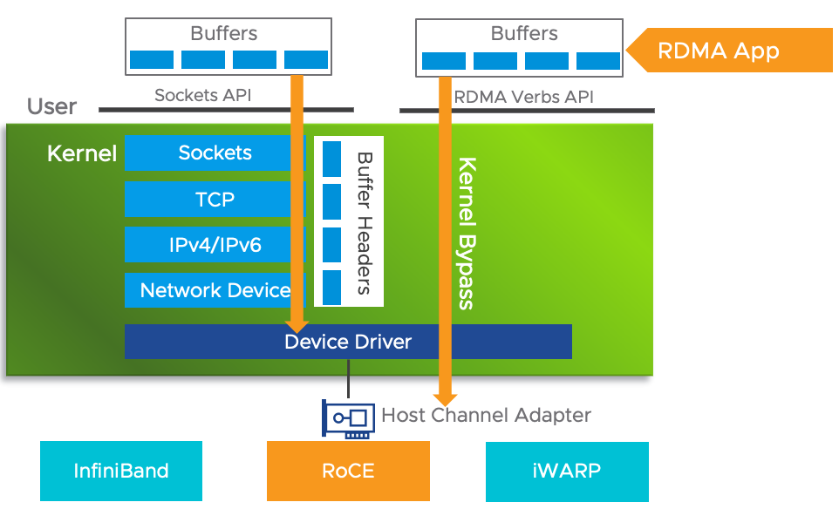
Without RDMA
Source
VMware

Slide 39
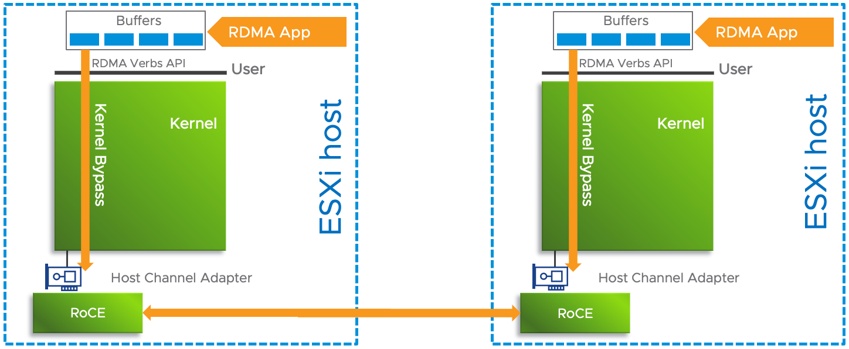
Without RDMA
Source
VMware

Slide 40
Understanding RDMA
Definition: RDMA is an extension of Direct Memory Access (DMA) technology, enabling direct memory access from one computer to another without CPU intervention.
Benefits: Significantly improves throughput and performance while reducing latency. This efficiency is due to the reduced need for CPU cycles to process network packets.

Slide 41
Comparing Traditional Data Path and RDMA
Traditional Data Path: Involves multiple layers from the user space sockets API down to the network fabric, consuming substantial CPU cycles.
RDMA Path: Bypasses kernel processing, directly accessing Host Channel Adapter (HCA). This results in lower latency and higher data throughput.

Slide 42
Overview of RDMA Transport Methods
InfiniBand: High-speed, low-latency networking primarily used in high-performance computing (HPC). Offers benefits in speed and efficiency.
RDMA over Converged Ethernet (RoCE): Utilizes Ethernet network while retaining the low-latency and high-throughput characteristics of RDMA.
iWARP: Internet Wide Area RDMA Protocol, enabling RDMA over TCP networks, making it suitable for long-distance communication.

Slide 43
SMB Direct and its Role in RDMA
SMB Direct: A feature of the Server Message Block (SMB) protocol, leveraging RDMA technology for network file sharing.
Efficiency in Data Transfer: SMB Direct allows for more efficient file access and transfer, significantly reducing CPU load and enhancing throughput.

